Slide 1

Big mountain resort

Slide 2
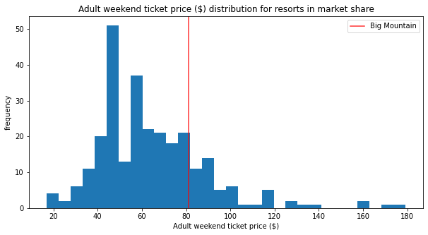
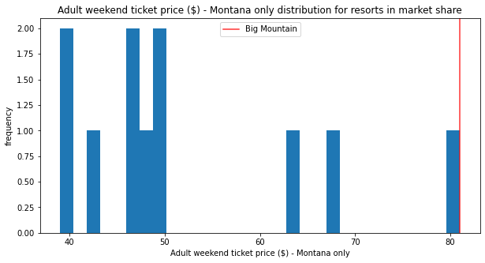
Problem Identification
Currently Big Mountain charges $81.00 for both weekend and weekday adult tickets
Increase revenue to cover the increased operational cost of $1.54 million per season
Do the current ticket price reflect the premium facilities in Big Mountain Resort?
Aim: identify a data-driven strategy that will help support an increase in ticket prices and suggest scopes for future investments.

Slide 3
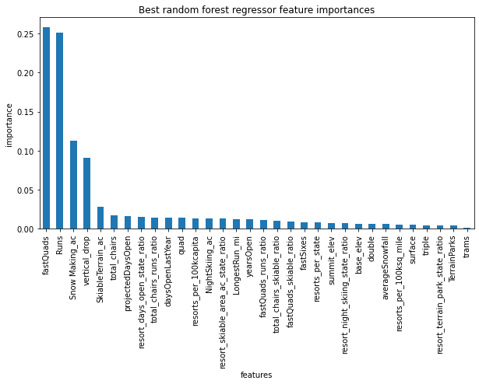
Recommendation- Key Features
Random Forest Model is deemed most suitable
The key features which support increases to ticket prices are identified in the graph on the left.

Slide 4
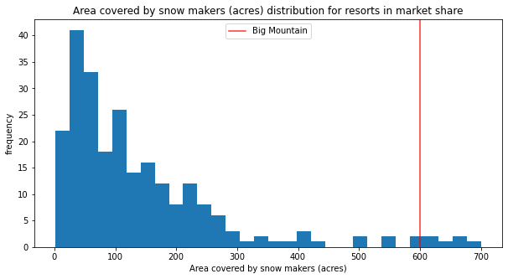
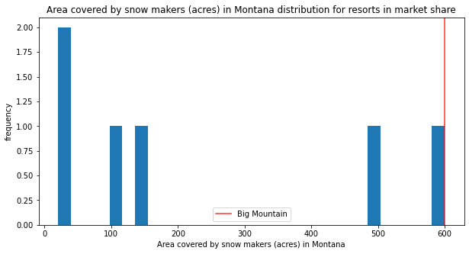
Results: Area covered by snow makers
Big Mountain has the highest area covered by snow makers in Montana and ranks quite highly for this feature nationally
An increase of at least 30 acres is predicted to support an increase in ticket prices by $1 (which should increase revenue by $1.75 million)
Skiers prefer snow makers to guarantee snow, however operational costs are unknown for snow making machines

Slide 5
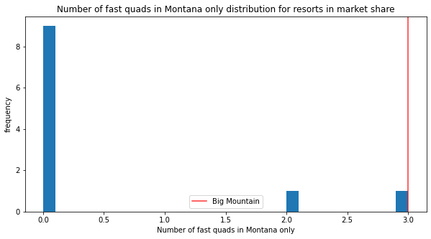
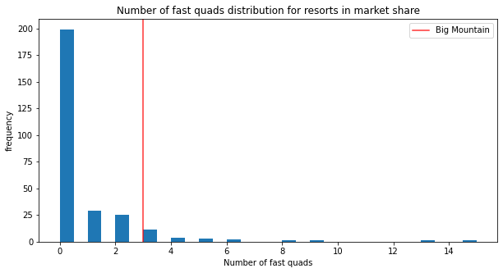
Results: Number of Four-Person Lifts
The model predicts an increase in the number of four person lifts by 1 supports an increase in ticket prices by $23.17
Increase in revenue is predicted to be $40.5 million
Problem: this model was not trained with operational costs of four person lifts
It’s interesting to note that most ski resorts don’t even have 1 fast four-person lift- but quite a few ski resorts in Montana have them.

Slide 6
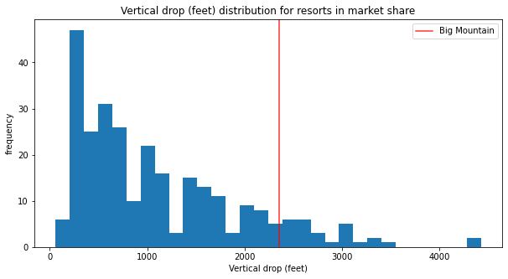
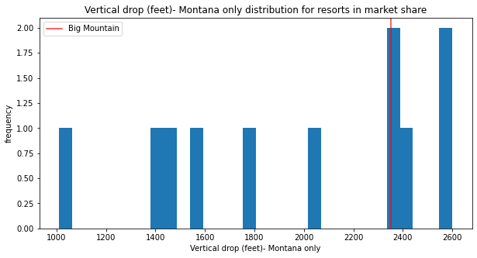
Results: Vertical Drop
Increase in vertical drop by a minimum 100ft is recommended.
This is predicted to support an increase in ticket prices of $1.70, and therefore an increase in revenue of $2.96 million.

Slide 7
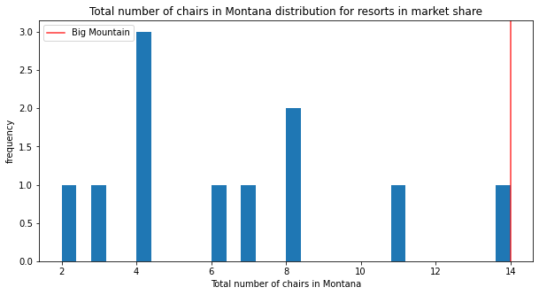
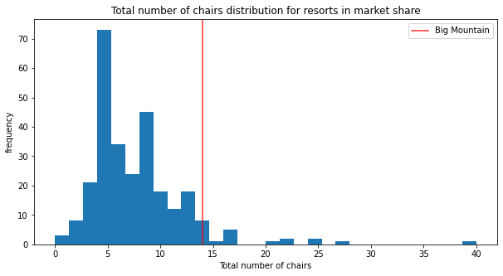
Results: Total number of chairslifts
The total number of chairlifts in Big Mountain is one of the highest compared to the other ski resorts.
The model predicts, an increase of two chairlifts can support an increase of ticket prices in $1.28, with a seasonal increase in revenue of $2.2 million.

Slide 8
Conclusion & Further Study
An increase of ticket price is recommended for Big Mountain Resort.
The main areas for investment recommended by this random forest model are increasing the number of four person chairs and increasing the total chairlifts at the ski resort.
Number of runs was initially identified to be a large influencer of ticket prices, however a minimum of 6 runs is predicted to support an increase of $0.94 per ticket.
Further study is required to train our model with the operational costs of snow makers, fast four person chairs, and increasing the vertical drop. This will help determine if the initial cost of the investments and the maintenance costs would be offset by the predicted increases in ticket prices.
It is important to investigate the breakdown of visitors during the week and the weekend, and to identify where the visitors are coming from: within Montana or from across the country. This will help determine whether ticket prices should be dependent on the day of the week or not.

